Slide 1

Miniproject(19AI701) – Review 2
DATA STORYTELLING WITH POWERBI
Submitted by:
SOWMIYA N (212221230106)
2021-2025 Batch
TEAM NO:TEAMDS06
Under the guidance of:
ARCHANA S H
Assistant Professor , Department of AIDS
DEPARTMENT OF ARTIFICIAL INTELLIGENCE AND DATA SCIENCE
SAVEETHA ENGINEERING COLLEGE
(Autonomous Institution – UGC, Govt. of India)
(Affiliated to Anna University, Approved by AICTE - Accredited by NBA & NAAC – ‘A’ Grade - ISO 9001:2015 Certified)
Saveetha Nagar, Thandalam, Chennai-602 105, TamilNadu, INDIA.

Slide 2
Agenda
Introduction
Research Paper 1- Data Visualization for Business Intelligence
Research Paper 2 - Data Visualization A Study of Tools and Challenges
Research Paper 3 – Microsoft PowerBI
Summary of LR
Outcome of LR
Architecture Diagram
Gantt Chart
Conclusion
References

Slide 3


Introduction
DATA STORYTELLING WITH POWERBI
Data storytelling: It leverages data as the basis for a compelling narrative to engage and persuade an audience.
Data visualization: It uses graphical elements to represent data for improved understanding.
Power BI: A Microsoft tool for data visualization and interactive reporting.

Slide 4
Reference Paper 1
Paper Title
Data Visualization for Business Intelligence
Problem statement
Business data is often complex and difficult to understand. This can make it difficult for businesses to make informed decisions.
Problem approach
The approach of the paper is to provide a comprehensive overview of business data visualization.
Data visualization can help to solve this problem by making business data more accessible and understandable.
The paper discusses the different types of data visualizations, the benefits of using data visualization, and the challenges of implementing data visualization.

Slide 5
Reference Paper 1
Advantages
Increased understanding of business data
Improved decision-making
Better communication of business insights
Improved User Focus
Drawbacks
Interpretation Variability: the meaning delivered through visualizations may be affected by a number of factors like color and orientation.
Cultural Adaptation : Adapting data visualization solutions in local culture
Future Scope
The future scope of data visualization is bright. As businesses become more data-driven, the demand for data visualization solutions is likely to increase. Additionally, new technologies, such as artificial intelligence and virtual reality, are creating new opportunities for data visualization.

Slide 6
Reference Paper 2
Paper Title
Data Visualization A Study of Tools and Challenges
Problem statement
The problem being addressed in the paper is the need for more effective ways to visualize and understand data.
Problem approach
The paper provides an overview of data visualization techniques and tools, as well as examples of how data visualization can be used to communicate information and identify trends.
Advantages
Universal Applicability
Access to Advanced Tools
Interactive Presentation
Clarity and Comprehension

Slide 7
Reference Paper 2
Disadvantages
Data Volume Challenge
Data Variety and Scalability
Cost and Tool Selection
Future Scope
Data Quality Management: To address data challenges, there will be a growing emphasis on data quality management and preprocessing techniques.
Data Storytelling: Data visualization will play a crucial role in data storytelling, helping convey narratives and insights effectively.

Slide 8
Reference Paper 3
Paper Title
Microsoft PowerBI
Problem statement
How to build a BI solution with Microsoft Power BI?
Problem approach
The research paper provides a theoretical overview of BI and Self-service BI, as well as an introduction to Microsoft Power BI. It then presents a test case demonstrating how to use Power BI to build a BI solution.
Advantages
It provides a comprehensive overview of BI and Self-service BI, including their history, definitions, and architectures.

Slide 9
Reference Paper 3
It introduces Microsoft Power BI and its main capabilities.
It presents a detailed test case demonstrating how to use Power BI to build a BI solution.
Drawbacks
The test case is relatively simple and does not cover all of the advanced features of Power BI
The paper does not discuss the challenges of implementing and using Power BI in a real-world setting.
Future Scope
Developing and testing more complex BI solutions using Power BI.
Discussing the challenges of implementing and using Power BI in a real- world settings.
Comparing Power BI to other BI tools on the market.

Slide 10
Summary of LR
Research | Technique | Features Used | Domain | Advantage / Disadvantage | Future Direction
Data Visualization in Business Intelligence Jack G Zheng , 2018 | Data visualization Data Analysis | Chart Diagrams Map Dashboards | Business intelligence Analytical Report | Increased understanding of business data Improved decision-making Interpretation Variability Cultural Adaptation | As businesses become more data-driven, the demand for data visualization solutions is likely to increase. Additionally, new technologies, such as artificial intelligence and virtual reality, are creating new opportunities for data visualization

Slide 11
Summary of LR
Research | Technique | Features Used | Domain | Disadvantage / Advantage | Future Direction
Data Visualization: A Study of Tools and Challenges Ahmad Tasnim Siddiqui , 2021 | Software Tools UI Elements Data visualization | Python Power BI Tableau R | Data visualization tools and techniques | Universal Applicability Interactive Presentation Cost and Tool Selection Data Variety and Scalability | Data visualization will play a crucial role in data storytelling, helping convey narratives and insights effectively. Ensuring ethical data visualization practices, transparency, and accuracy will gain importance, driven by the need for trustworthy visualizations.

Slide 12
Summary of LR
Research | Technique | Features Used | Domain | Disadvantage / Advantage | Future Direction
Microsoft Power BI Amrapali Bansal, A. K. Upadhyay 2017 | Data Cleaning EDA Data visualization | Microsoft Power BI | Business intelligence Commercial | It provides a comprehensive overview of BI and Self-service BI, including their history, definitions, and architectures The test case is relatively simple and does not cover all of the advanced features of Power BI | Developing and testing more complex BI solutions using Power BI. Discussing the challenges of implementing and using Power BI in a real-world settings. Comparing Power BI to other BI tools on the market. .

Slide 13
Outcome of the LR - Scope of the project
From these papers, we conclude that data visualization is an important tool for businesses and organizations of all sizes.
It can be used to
improve decision-making,
communicate insights to stakeholders, and
engage with customers.

Slide 14
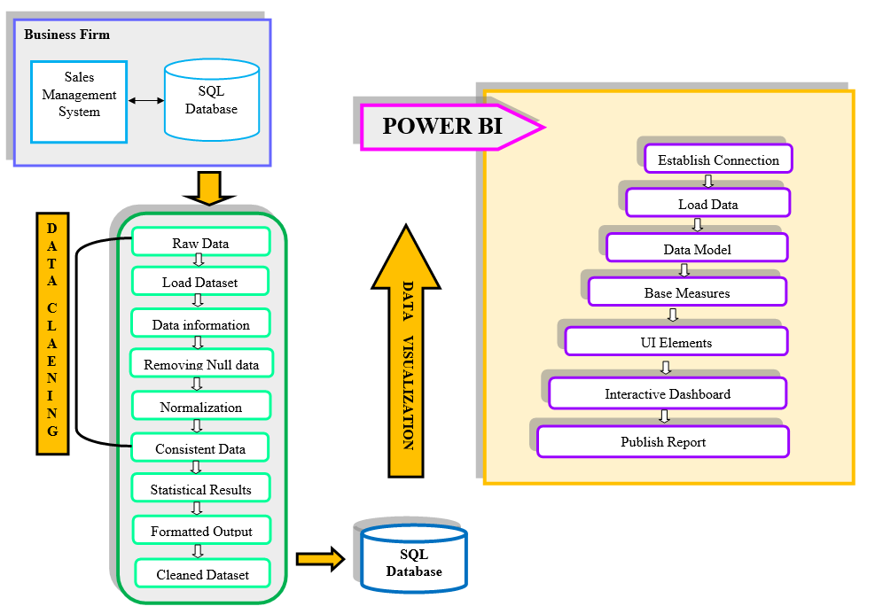
Architecture Diagram

Slide 15
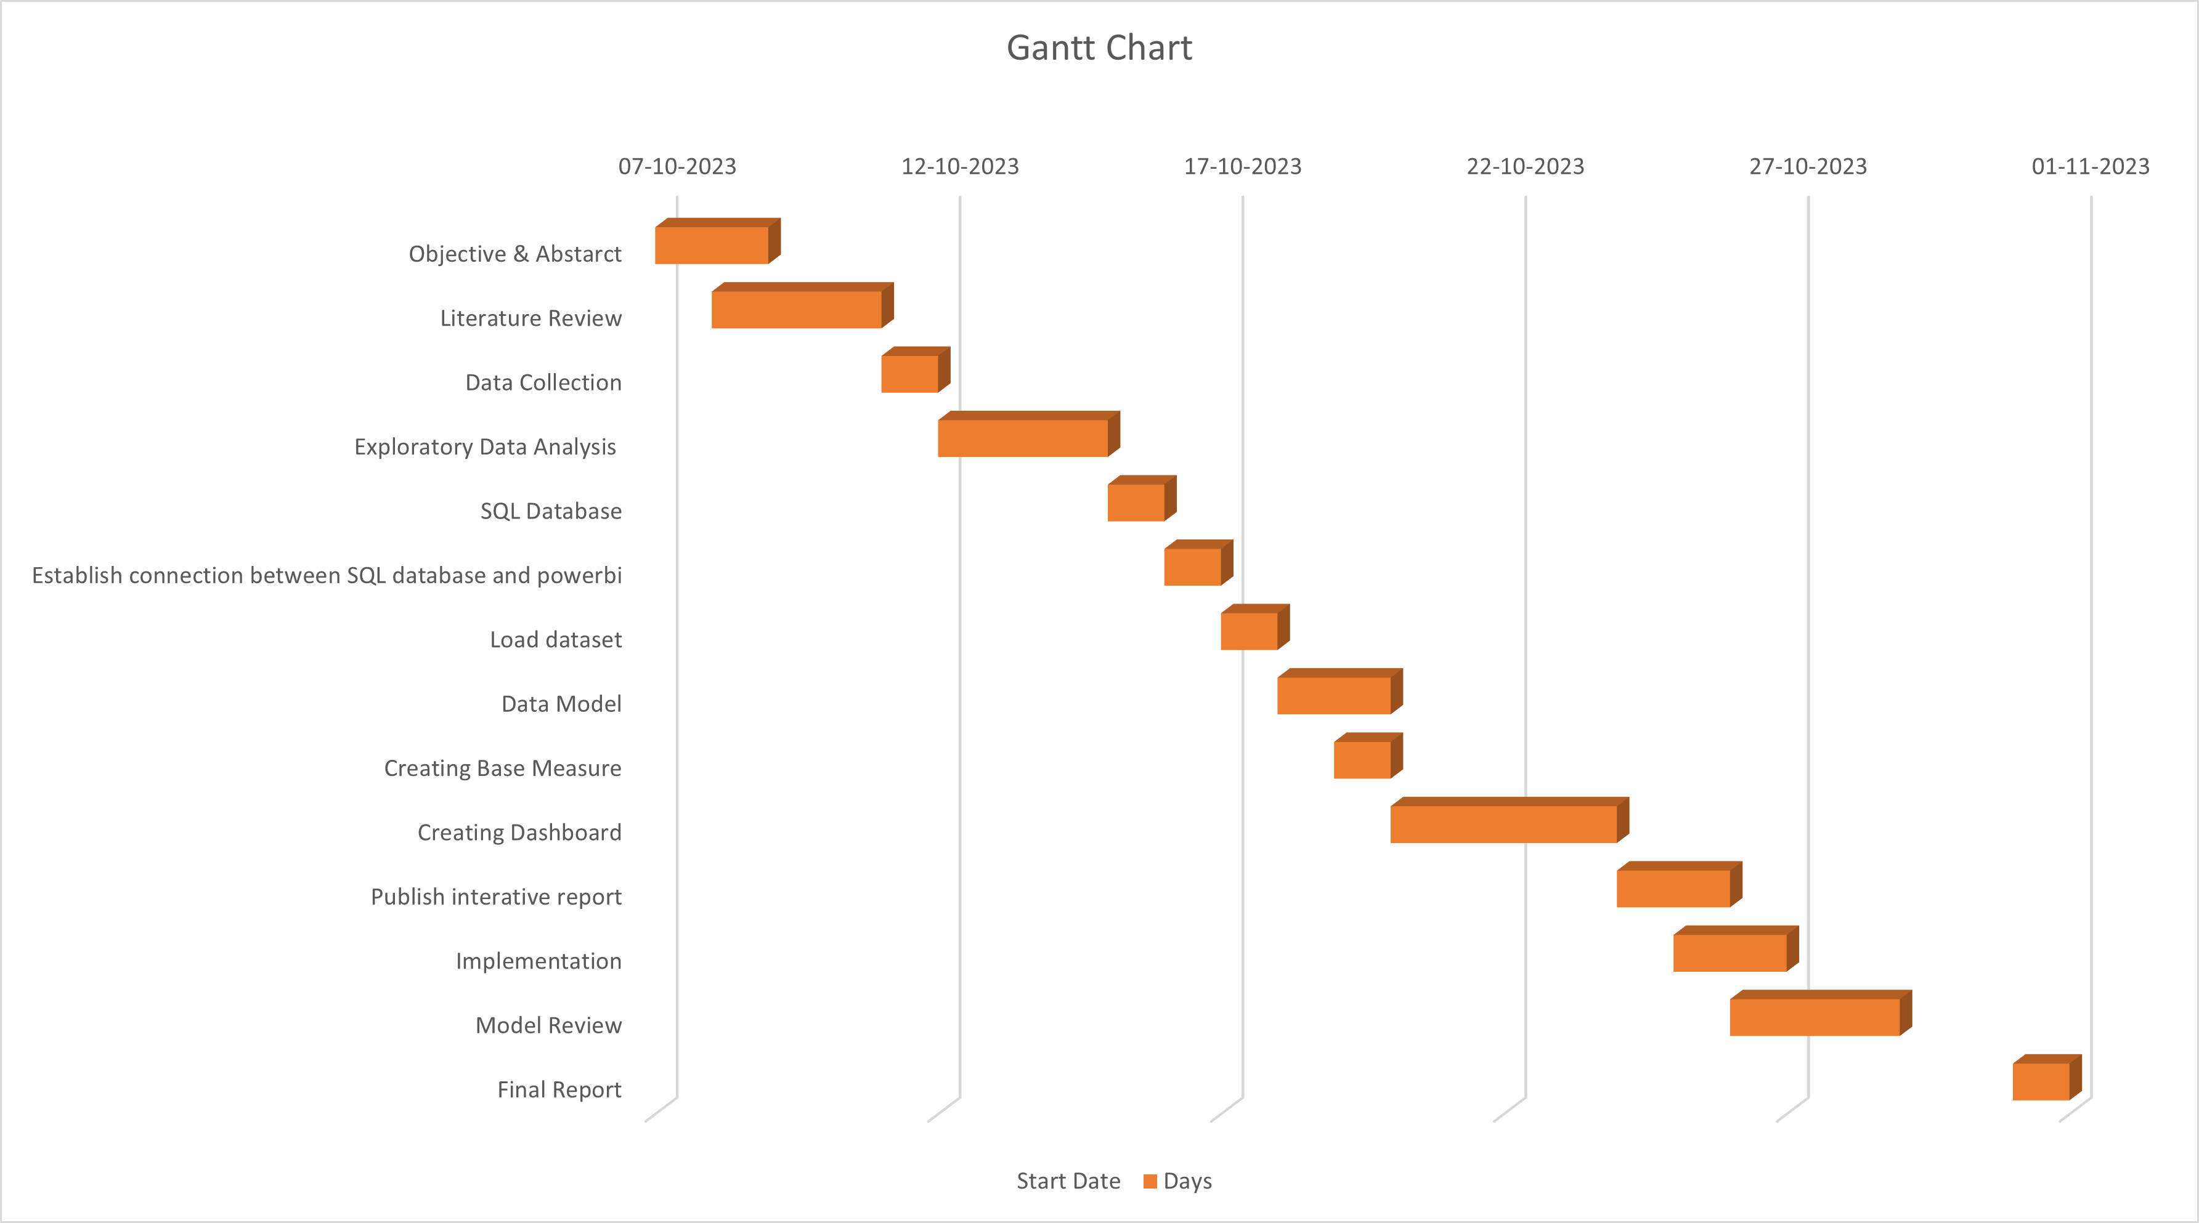
Gantt Chart

Slide 16
Conclusion
The significance of the project is that it provides a method for generating interactive reports that can be used to visualize numerical data and identify patterns and trends. This can help business users make more informed decisions.

Slide 17
References
PAPER 1
https://www.researchgate.net/publication/321804138_Data_Visualization_for_Business_Intelligence
PAPER 2
https://www.researchgate.net/publication/352735133_Data_Visualization_A_Study_of_Tools_and_Challenges
PAPER 3
https://www.ijsce.org/wp-content/uploads/papers/v7i3/C3011077317.pdf

